Slide 1
The Neurobiology of Sexual Assault
Rebecca Campbell, Ph.D.
Professor of Psychology
Michigan State University
.

Slide 2
The National Center for Victims of Crime is pleased to provide the slides used in our April 23, 2013 Webinar, “Sexual Assault Cold Case Survivors and the Neurobiology of Trauma.”
Please be advised that these materials are provided through the generosity of our presenter faculty. All copyright laws apply to the proper use and crediting of these materials.

Slide 3
Today’s Presentation
The neurobiology of sexual assault
Introduction to neurobiology
During the assault: What are victims’ experiencing?
Take home lessons for first responders
For current cases
For cold cases (i.e., victim notification)
Q&A (as best we can!)

Slide 4
A Brief Intro to Neurobiology
“This Is Your Brain”

Slide 5
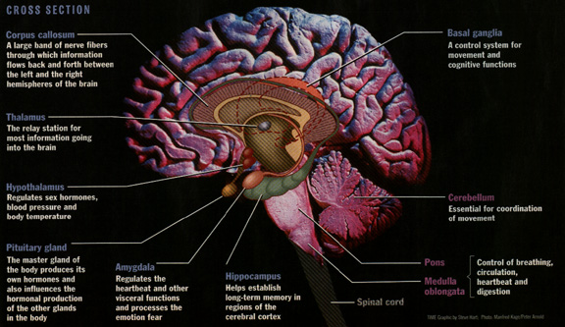
Brain Regions Impacted by Trauma

Slide 6
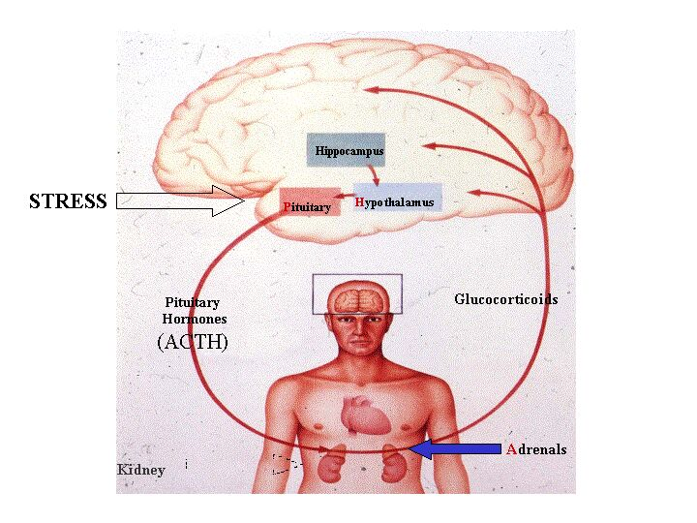
Brain-Body Regions Impacted by Trauma
HPA Axis
Balances body following stress by releasing of various hormones/chemicals
(Southwick et al., 2005)

Slide 7
Brain-Body Regions Impacted by Trauma
Catecholomines: Fight or flight response
Cortisol: Energy available
Opiods: Prevent pain
Oxytocin: Promotes good feelings
(Southwick et al., 2005)

Slide 8
Brain Regions Impacted by Trauma

Slide 9
Memory Processes Impacted by Trauma
Hippocampus processes information into memories
Encoding = Organizing sensory information
Consolidation = Grouping information into memories and storing them
Amygdala specializes in the processing of emotional memories (works with the hippocampus)
Both structures are VERY sensitive to hormonal fluctuations
(Southwick et al., 2005)

Slide 10
Memory Processes Impacted by Trauma
Hippocampus processes information into memories
Encoding = Organizing sensory information
Consolidation = Grouping information into memories and storing them
Amygdala specializes in the processing of emotional memories (works with the hippocampus)
Both structures are VERY sensitive to hormonal fluctuations
(Southwick et al., 2005)

Slide 11
Memory Processes Impacted by Trauma
Hippocampus processes information into memories
Encoding = Organizing sensory information
Consolidation = Grouping information into memories and storing them
Amygdala specializes in the processing of emotional memories (works with the hippocampus)
Both structures are VERY sensitive to hormonal fluctuations
(Southwick et al., 2005)

Slide 12
Memory Processes Impacted by Trauma
Hippocampus processes information into memories
Encoding = Organizing sensory information
Consolidation = Grouping information into memories and storing them
Amygdala specializes in the processing of emotional memories (works with the hippocampus)
Both structures are VERY sensitive to hormonal fluctuations
(Southwick et al., 2005)

Slide 13
Memory Processes Impacted by Trauma
Hippocampus processes information into memories
Encoding = Organizing sensory information
Consolidation = Grouping information into memories and storing them
Amygdala specializes in the processing of emotional memories (works with the hippocampus)
Both structures are VERY sensitive to hormonal fluctuations
(Southwick et al., 2005)

Slide 14
Memory Processes Impacted by Trauma
Hippocampus processes information into memories
Encoding = Organizing sensory information
Consolidation = Grouping information into memories and storing them
Amygdala specializes in the processing of emotional memories (works with the hippocampus)
Both structures are VERY sensitive to hormonal fluctuations
(Southwick et al., 2005)

Slide 15
Like These . . .
Catecholomines: Fight or flight response
Cortisol: Energy available
Opiods: Prevent pain
Oxytocin: Promotes good feelings

Slide 16
Like These . . .
Catecholomines: Fight or flight response
Cortisol: Energy available
Opiods: Prevent pain
Oxytocin: Promotes good feelings
THESE HORMONES IMPAIR MEMORY CONSOLIDATION
(Southwick et al., 2005)

Slide 17
During the Assault
“This Is Your Brain On Trauma”

Slide 18
What Happens During A Sexual Assault
Amygdala Detects Threat
Activates Hypothalamus
HPA Axis Kicks In
Hormonal Flood
SOURCE: Banks, 2002; Southwick et al., 2005

Slide 19
What Happens During A Sexual Assault
Cathecholamines Increase
Damage to memory
Impairs rational thought
Corticosteriods Decrease
Reduces energy available
Opiods Increase
Causes flat affect
Impair immune functioning
SOURCE: Banks, 2002; Southwick et al., 2005

Slide 20
What Happens During A Sexual Assault
Amygdala Detects Threat
Activates Hypothalamus
HPA Axis Kicks In
Hormonal Flood
Can Trigger a Complete “Shut Down”
in the Body
SOURCE: Banks, 2002; Southwick et al., 2005

Slide 21
Tonic Immobility (TI)
AKA: “Rape-induced paralysis”
Autonomic (uncontrollable) mammalian response in extremely fearful situations
Increased breathing, eye closure, paralysis
12-50% rape victims experience TI during assault
TI is ~more common in victims who have been assaulted before (childhood, adolescence, or adult)
SOURCE: Fuse et al., 2007; Galiano et al., 1993; Heidt et al., 2005

Slide 22
Case Study: Tonic Immobility
College house party
20 year-old woman
Agreed to go back to one of the bedrooms
Told man to stop
He didn’t and she froze
Lay immobile afterwards
Men lined up on the porch to take turns raping her

Slide 23
Case Study: Tonic Immobility
Victim had rape kit and filed a police report
Police didn’t pick up rape kit (“a sloppy mess”)
Police closed case
“She just laid there, so she must have wanted it . . .
no one wants a have a train pulled on them, so if she laid there and took it, she must have wanted it.”

Slide 24
Case Study: Tonic Immobility
Victim had rape kit and filed a police report
Police didn’t pick up rape kit (“a sloppy mess”)
Police closed case
The real reason
TONIC IMMOBILITY
A DOCUMENTED NEUROBIOLOGICAL CONDITION

Slide 25
What Happens During A Sexual Assault

Slide 26
What Happens During A Sexual Assault
Increased Stress Hormones
Impaired Functioning in Hippocampus
Memories Fragmented
Memory Activation Can Be Unpredictable and Traumatic
SOURCE: Koss et al., 1995, 1996; Roozendaal et al., 2009; Rubin et al., 2008

Slide 27
What Happens During A Sexual Assault
Increased Stress Hormones
Impaired Functioning in Hippocampus
Memories Fragmented
Memory Activation Can Be Unpredictable and Traumatic
Events of the Assault CAN Be Recalled Accurately
SOURCE: Koss et al., 1995, 1996; Roozendaal et al., 2009; Rubin et al., 2008

Slide 28
What Happens During A Sexual Assault
Increased Stress Hormones
Impaired Functioning in Hippocampus
Memories Fragmented
Memory Activation Can Be Unpredictable and Traumatic
BUT . . .
Alcohol use during the assault may prevent encoding, which means there’s nothing to retrieve
Events of the Assault CAN Be Recalled Accurately
SOURCE: Koss et al., 1995, 1996; Roozendaal et al., 2009; Rubin et al., 2008

Slide 29
Case Study: Memory Fragmentation

Slide 30
Case Study: Memory Fragmentation
“My life was saved by a cup of coffee.
I think about that a lot.
That’s what saved me from going over the edge.”

Slide 31
Case Study: Memory Fragmentation
25 year-old woman
Raped by a friend’s brother at 4th July party
Filed police report
Detective interview was when it all went to hell
“He wouldn’t let up, pounding me with question after question after question. Trying to trick me, trying to get me to mess up. I wanted to say, ‘hold on, give me a minute to think’. No, he kept coming at me.”

Slide 32
Case Study: Memory Fragmentation
“Then I guess it was classic good-cop / bad-cop. He stormed off and another detective sat down next to me. He offered me a cup of coffee.
It’s 90 f’ing degrees outside and I’m a wreck. Coffee? OK fine. How do I take it? WHAT? Why does he care how I take my coffee?
Well, he did.
He made me coffee. He gave me a long time to just sit, collect my thoughts.

Slide 33
Case Study: Memory Fragmentation
“We talked it through. And I didn’t feel rattled and freaked out. I’m sure I was incoherent and he just let it roll. He was patient.
I felt like I was piecing it together, like a puzzle, we were putting together a puzzle together.
And drinking coffee.

Slide 34
Case Study: Memory Fragmentation
I: So, why did you do that? (give her the coffee)
R: It helps. Not the coffee so much, just the moment to let it all
come together in their heads.
I: What do you mean?
R: I don’t know why it’s like that, I’ve just noticed that over the
years. If you give them a few minutes to breathe . . . . it
starts to make more sense. I don’t know why, it just does.

Slide 35
Case Study: Memory Fragmentation
I: So, why did you do that? (give her the coffee)
R: It helps. Not the coffee so much, just the moment to let it all
come together in their heads.
I: What do you mean?
R: I don’t know why it’s like that, I’ve just noticed that over the
years. If you give them a few minutes to breathe . . . . it
starts to make more sense. I don’t know why, it just does.
MEMORY CONSOLIDATION
A DOCUMENTED NEUROBIOLOGICAL CONDITION

Slide 36
Case Study: Memory Fragmentation
I: Were you worried that if you gave her some time, she’d just
make something up?
R: Nah, not really. I mean, some victims lie, but most don’t.
Besides, if they’re lying, we’ll catch ‘em at it eventually. I
think it’s just hard for victims to talk about and we just need
to have a little patience.

Slide 37
Case Study: Memory Fragmentation
I: Were you worried that if you gave her some time, she’d just
make something up?
R: Nah, not really. I mean, some victims lie, but most don’t.
Besides, if they’re lying, we’ll catch ‘em at it eventually. I
think it’s just hard for victims to talk about and we just need
to have a little patience.
MEMORY FRAGMENTATION
A DOCUMENTED NEUROBIOLOGICAL CONDITION

Slide 38
Take Home Lessons
Implications for Current & Cold Cases

Slide 39
CURRENT CASES
Assaults that occurred recently & are reported ~ 24-96 hours
COLD CASES
Assaults that occurred a long time ago, but may be re-opened due to new evidence, SAK testing, CODIS hit, etc.

Slide 40
. . . BUT from the perspective of the victim . . .

Slide 41
COLD CASES
Assaults that occurred a long time ago, but may be re-opened due to new evidence, SAK testing, CODIS hit, etc.

Slide 42
CURRENT CASES
Assaults that occurred recently & are reported ~ 24-96 hours
FEEL LIKE
COLD CASES
Assaults that occurred a long time ago, but may be re-opened due to new evidence, SAK testing, CODIS hit, etc.

Slide 43
What Is Victim Notification?
Reactivation of the assault memories
HPA Axis re-activation will cause neurobiological distress
Could trigger flashbacks and other symptoms
Could exacerbate PTSD and/or other MH issues
Could increase substance use/abuse
Could trigger substance abuse relapse
A “cold case” feels like a current case

Slide 44
Take Home Lessons
Neurobiological changes can lead to flat affect or “strange” emotions or emotional swings
“Hormonal soup”
Misinterpreted as being cavalier about it or lying
Wide range of emotions are in fact normal and it can be helpful to normalize those reactions
SOURCE: Campbell & Patterson, 2011

Slide 45
Take Home Lessons
Neurobiological changes can make memory consolidation difficult
Story may come out fragmented or “sketchy”
Misinterpreted as evasiveness or lying
The content of the memory is accurate, just may take some time and patience for it to come together
SOURCE: Campbell & Patterson, 2011; Koss et al., 1995, 1996

Slide 46
Take Home Lessons
Tonic immobility is often frightening to victims
Associated with increased self-blame
Associated with decreased likelihood of seeking help
Friends, family, service providers reactions to a disclosure of TI are often hurtful
Helpful to explain what TI is and normalize it
SOURCE: Fuse et al., 2007; Galiano et al., 1993; Heidt et al., 2005; Marx et al., 2008

Slide 47
Take Home Lessons
Services for victims
Advocacy to buffer effects of continued contact with the legal system
Mental health services to address long-term mental and physical health impact
Substance abuse services (as needed)
Services that are culturally appropriate
Services that are developmentally appropriate
(Campbell, 2008)

Slide 48
Conclusions
Linking Research to Practice

Slide 49
Concluding Thoughts
There are neurobiological reasons for victims’ behavior
The criminal justice system is “a180” from what victims need psychologically and neurologically
Every contact is an opportunity to help . . . or hurt

Slide 50
This project was supported by Grant No.2011-TA-AX-K048 awarded by the Office on Violence Against Women, U.S. Department of Justice. The opinions, findings, conclusions, and recommendations expressed in this publication/program/exhibition are those of the author(s) and do not necessarily reflect the views of the Department of Justice, Office on Violence Against Women.

